Slide 1



SafeBoda Analytics Report

Slide 2
Executive Summary
At SafeBoda, a reasonable percentage of Passengers or Prospective customers cancel their Boda requests after using the Boda App to make a Boda request. This may lead to a significant loss in the incremental revenue of the organization and also discourage a prospective customer from using their services again in the nearest future.
Therefore, SafeBoda request for the services of a Data Analyst to analyze and identify the behavioral patterns of the Passengers generating the cancelled requests and proffer the best possible ways for SafeBoda to optimize their revenue. The analysis was conducted based on a random sample of 82,868 Passengers that generated a Boda request using the SafeBoda App within 11th – 17th of January 2020.
The report is in three parts – Passenger Analytics, Location Intelligence and Trip Analytics. Firstly, through advanced Passenger analytics we identified patterns and behaviors of Passengers generating Cancelled requests across multiple dimensions and recommended interventions to address these patterns. Then, we applied the concepts of data aggregation and summary to identify the prevalent Cancellation locations in order to find ways to optimize the cancellation rates in those locations. Advance analytics method was also used to identify patterns in Boda requests both on daily and hourly to have a broad understanding of rush-hour period.
Below are the highlights of the report:
Out of the ~83k Passengers, ~54k (65%) unique Passengers performed only completed trips while a significant 12% experienced cancellation requests only
65% (~54K) of the Passengers that performed only completed trips generated a total of 82K completed trips which constitutes to about 50% of the entire order request in the dataset
There is a direct relationship between count of Passengers who generated Boda requests and the volume of Boda requests generated. For all Passengers that generated a cancelled request, 96% of them made a reorder for a Boda ride.
SafeBoda experiences more order requests on Fridays and most cancellation rates on Fridays and Mondays. Majority of the orders are generated between the hour of 8 AM – 9 PM
Central and Nakawa Subcounty takes up to 61% and 49% respectively of order requests generated within the 7 days period, they also have a good percentage of completed trips in that region even with the ratio of ~7 trips to a driver.
CIVIC CENTRE and NAKASERO IV parish in Central Subcounty have both the most completed trip rate and cancellation rate due to the high rate of order requests in that region compared to the number of available Drivers.
The analysis is based on a 7-days sample of SafeBoda order requests

Slide 3
Part 1: Passenger Analytics
Part 1: Passenger Analytics

Slide 4
Passenger’s requests distribution by trip status
In the 7 days period (11th January 2020 – 17th January 2020), ~83k unique passengers performed order request using the SafeBoda App
65% (~54K) of the Passengers have not cancelled their trips within the 7-days period, 12% (~10K) Passengers have not completed any trip in the 7-days period while 23% of the Passenger base have experienced both completed trips and cancelled request
Passengers that have not cancelled any order request contributed to 50% of Completed trips in the 7-days period
Split of Passengers by trip status in the 7-days period
Volume of trips by trip status in the 7-days period
Completed
82,616 (50%)
Count of Passengers that generated order request in the 7-days period
Completed only
54,139 (65%)
Completed
41,735 (25%)
Not only Completed
18,963 (23%)
Cancelled
27,700 (17%)
Cancelled only
9,766 (12%)
Cancelled
11,800 (7%)
The analysis is based on a 7-days sample of SafeBoda order requests

Slide 5
Daily distribution of Passengers by trip status
Friday recorded the highest Passenger base to generate order requests contributing 26% of the total Passenger base in the 7 days period while Sunday has the lowest Passenger base to generate order requests (13%).
In terms of numbers, Friday recorded for highest completed trips and cancelled requests but Saturday was more successful in terms of trips completed and cancellation rate with 85% and 23% of the Passenger base respectively
Passengers who Generated Order request by Days of the week
Count of Passengers that generated order request in the 7-days period
PASSENGERS
20,191 (24%)
20,730 (25%)
21,263 (26%)
20,392 (25%)
21,577 (26%)
16,983 (20%)
10,706 (13%)
Sunday
Monday
Tuesday
Wednesday
Thursday
Friday
Saturday
Split of Passengers that generated order request by trip status
COMPLETED
Count of Passengers that generated order request in the 7-days period
CANCELLED
16,660 (83%)
17,357 (84%)
17,684 (83%)
16,972 (83%)
17,701 (82%)
14,361 (85%)
8,762 (82%)
5,429 (27%)
5,246 (25%)
5,546 (26%)
5,296 (26%)
5,908 (27%)
3,947 (23%)
2,782 (26%)
Sunday
Monday
Tuesday
Wednesday
Thursday
Friday
Saturday
The analysis is based on a 7-days sample of SafeBoda order requests

Slide 6
Distribution of Passengers in each Subcounty by trip status
Central had the highest Passenger base to generate order request contributing to ~41% of the entire Passenger base in the 7 days period while Wakiso ward B, Katabi, Nsangi and Gombe wakiso have a significantly very low percentage of the Passenger base
However, a larger percentage of the passenger completes their trip with Central and Nakawa as top 2 Subcounty with both Completed trips and cancelled requests
Passengers who Generated Order request by Subcounty
Count of Passengers that generated order request in the 7-days period
PASSENGERS
33,933 (41%)
26,547 (32%)
15,378 (19%)
3,703 (4%)
14,595 (18%)
2,068 (2%)
1,149 (1%)
13,053 (16%)
55 (0%)
20 (0%)
160 (0%)
11 (0%)
386 (0%)
16 (0%)
163 (0%)
271 (0%)
6 (0%)
522 (1%)
Split of Passengers that generated order request in each Subcounty by trip status
Completed
Cancelled
Count of Passengers that generated order request in the 7-days period
28,885
22,943
12,893
12,224
10,982
39
9,789
18
8
4,463
7,526
15
19
3
54
3
1,130
124
130
609
2
299
3,658
49
81
Busiro
Central
gombe wakiso
Kasangati
Katabi
Kawempe
Kira
Kyengera
Makindye
Nakawa
Nangabo
Nansana
Nsangi
Others
Rubaga
Ssisa
Wakiso
Wakiso ward B
The analysis is based on a 7-days sample of SafeBoda order requests

Slide 7
Distribution of Passengers by re-ordered requests
In the 7 days period (11th January 2020 – 17th January 2020), ~29k unique Passengers cancelled their order request
96% (~29K) of the Passengers reordered after 10 minutes while ~100% (~29K) of the Passengers reordered before the end of the day. However, a significant 6% of the passengers did not reorder after 10 minutes of request cancellation
Split of Passengers that cancelled their Boda request by 10 minutes reorder
Split of Passengers that cancelled their Boda request by End of Day (EoD) reorder
Count of Passengers that cancelled their Boda request in the 7 days period
Reordered
27,564 (96%)
Reordered
28,640 (100%)
Not reordered
1,821 (6%)
Not reordered
133 (0%)
The analysis is based on a 7-days sample of SafeBoda order requests

Slide 8
Performance of top 10 SafeBoda drivers by trip status
In terms of efficiency, Driver with driver id 791284 had the highest trip completion rate of 96% while the Driver with driver id 169264 had the highest trip completed and also the highest cancellation rate amongst them
However, Driver with driver id 1046753 has the highest cancellation rate with ~79% with 453404 and 863588 joining the pack with 65% and 59% cancellation rate respectively
COMPLETED
CANCELLED
Top 10 Drivers by trip completion rate
51 (73%)
50 (96%)
49 (80%)
49 (80%)
48 (89%)
48 (89%)
48 (91%)
47 (81%)
47 (81%)
47 (84%)
19 (27%)
12 (20%)
12 (20%)
11 (19%)
11 (19%)
2 (4%)
6 (11%)
6 (11%)
5 (9%)
9 (16%)
169264
791284
807318
797877
941152
644321
60306
74105
1125496
177946
Top 10 Drivers by trip cancellation rate
38 (79%)
34 (58%)
34 (58%)
37 (60%)
36 (62%)
33 (60%)
25 (42%)
25 (42%)
25 (40%)
24 (59%)
28 (56%)
26 (54%)
22 (65%)
22 (40%)
22 (44%)
22 (46%)
22 (38%)
17 (41%)
12 (35%)
10 (21%)
1046753
1036584
747782
43821
863588
453404
1156148
33785
807344
1148880
The analysis is based on a 7-days sample of SafeBoda order requests

Slide 9
Part 1: Passenger Analytics
Part 2: Trip Analytics

Slide 10
Trip distribution by trip status
In the 7 days transacting, ~124k (76%) of Boda requests are completed trips while ~39.5K (24%) were cancelled trips
However, ~38K (95%) of the cancelled request were reordered within 10 minutes of cancellation but a significant 5% Boda requests were not reordered within the 10 minutes timeframe
Count of Boda request Generated in the 7 days period
Split of Boda request by trip status in the 7 days period
Split of trips that was reordered withing 10 minutes of cancellation
Completed
124,351 (76%)
Reordered
37,638 (95%)
Cancelled
39,500 (24%)
Not reordered
1,862 (5%)
The analysis is based on a 7-days sample of SafeBoda order requests

Slide 11
Daily Trip distribution by trip status
Friday recorded the highest Boda request due to the fact that it is the end of the week contributing 33% of the total Boda requests the 7 days period while Sunday had the lowest with just 15%
However, in terms of trip status, Saturday was more efficient in completion rates and cancellation rate but Wednesday had the highest trip completed in the 7 days period
Distribution of Boda requests by Days of the week in the 7 days period
Count of Boda request Generated in the 7 days period
PASSENGERS
25,321 (31%)
25,925 (31%)
26,662 (32%)
25,414 (31%)
27,117 (33%)
20,620 (25%)
12,792 (15%)
Sunday
Monday
Tuesday
Wednesday
Thursday
Friday
Saturday
Distribution of Boda requests by trip status in each day of the week
COMPLETED
CANCELLED
Count of Boda request Generated in the 7 days period
18,987 (75%)
19,835 (77%)
20,250 (76%)
19,337 (76%)
20,247 (75%)
16,069 (78%)
9,626 (75%)
6,334 (25%)
6,090 (23%)
6,412 (24%)
6,077 (24%)
6,870 (25%)
4,551 (22%)
3,166 (25%)
Sunday
Monday
Tuesday
Wednesday
Thursday
Friday
Saturday
The analysis is based on a 7-days sample of SafeBoda order requests

Slide 12
Hourly trend of Trips by trip status
The trend below follows a relatively normal distribution with most trips observed during the hour of 8 AM to 10 PM in the evening, but Monday and Friday experience a relatively higher cancellation rate during the closing hour of the day. Sundays still observes the lowest rate in terms of Boda requests, trip completion, and cancellation rate
Total Request
Completed Trips
Cancelled Trips
1,598
1,655
1,543
1,529
1/11/20 h:01
1/12/20 h:01
1/13/20 h:01
1/14/20 h:01
1/15/20 h:01
1/16/20 h:01
1/17/20 h:01
1/18/20 h:01
The analysis is based on a 7-days sample of SafeBoda order requests

Slide 13
Part 1: Passenger Analytics
Part 3: Location Analytics

Slide 14
Distribution of Parishes by Subcounty
In the 7 days period, Boda requests were generated in 17 unique Subcounties and 150 parishes subsequently
Nakawa followed by Makindye has the highest number of parishes taking up to 18% and 17% respectively of the total number of Parishes while Katabi, Busiro, and Gome wakiso has the least with just a single parish
Count of unique Parishes per Subcounty in the 7 days period of transaction
Ssisa
3 (2%)
Count of unique Subcounties in the 7 days period of transaction
Count of unique Parishes in the 7 days period of transaction
Kira
2 (1%)
Wakiso ward B
2 (1%)
Kyengera
8 (5%)
Katabi
1 (1%)
Nansana
6 (4%)
Busiro
1 (1%)
17
150
Others
2 (1%)
Nsangi
1 (1%)
Kawempe
21 (14%)
Nakawa
27 (18%)
Kasangati
4 (3%)
Wakiso
7 (5%)
Makindye
26 (17%)
gombe wakiso
1 (1%)
Nangabo
6 (4%)
Rubaga
14 (9%)
Central
18 (12%)
The analysis is based on a 7-days sample of SafeBoda order requests

Slide 15
Distribution of Boda requests in each Subcounty by trip status
Central and Kakawa subcounty has the highest Boda requests with 61% and 49% of the total request ordered in the 7 days period while Wakiso ward B has the least Boda request of Just 6 orders in 7 days
However, both Central and Nakawa subcounty still have a good percentage of trips completed compared to other subcounty but Wakiso and Kyengera have a relatively higher percentage of cancelled requests compared to the trips completed
Count of Boda request Generated in the 7 days period
Distribution of Boda requests by Subcounty
BODA REQUESTS
41,015 (49%)
50,674 (61%)
2,636 (3%)
1,433 (2%)
21,908 (26%)
305 (0%)
21,100 (25%)
18,349 (22%)
195 (0%)
4,864 (6%)
6 (0%)
11 (0%)
61 (0%)
21 (0%)
190 (0%)
24 (0%)
459 (1%)
600 (1%)
Distribution of Boda request in Subcounty by trip completion and cancellation rate
Count of Boda request Generated in the 7 days period
Completed
Cancelled
38,626 (76%)
31,719 (77%)
16,466 (75%)
15,741 (75%)
13,898 (76%)
3,544 (73%)
1,925 (73%)
138 (71%)
6 (100%)
321 (70%)
8 (73%)
42 (69%)
1,085 (76%)
18 (86%)
9,296
134 (71%)
214 (70%)
21 (88%)
445 (74%)
12,048
57
1,320
0
138
3
711
19
348
3
5,442
56
91
5,359
3
155
4,451
Ssisa
Kira
Wakiso ward B
Kyengera
Katabi
Nansana
Busiro
Others
Nsangi
Kawempe
Nakawa
Kasangati
Wakiso
Makindye
gombe wakiso
Nangabo
Rubaga
Central
The analysis is based on a 7-days sample of SafeBoda order requests

Slide 16
Distribution of average travelling and waiting time in minutes by Subcounty
The chart below shows that Wakiso ward B and Busiro has the highest travelling time on average with 36 minutes while Central, Kawempe, and Nsangi has the least travelling time on average with 17 minutes
However, a significantly high waiting time was observed in Kira subcounty with 79 minutes due to maybe system error or Passenger forgetting to cancel the request after making a Boda order but Kasangati and Rubaga has the highest waiting time with ~22 minutes
Distribution of Passenger’s travelling time with Boda by Subcounty
Travelling Time
Distribution of Passenger’s waiting time before driver arrives or a cancelled request by Subcounty
Waiting Time
2
0
5
0
3
1
2
4
4
Ssisa
Kira
Wakiso ward B
Kyengera
Katabi
Nansana
Busiro
Others
Nsangi
Kawempe
Nakawa
Kasangati
Wakiso
Makindye
gombe wakiso
Nangabo
Rubaga
Central
The analysis is based on a 7-days sample of SafeBoda order requests

Slide 17
Top 10 Parishes with highest Boda requests and cancelled Boda requests
In the 7 days transaction period, CIVIC CENTRE and NAKASERO IV in Central Subcounty had the top highest Boda requests contributing to ~5% of the total requests followed by BUKOTO II and NTINDA in Nakawa
Consequently, CIVIC CENTRE and NAKASERO IV in Central subcounty had the highest cancelled requests with 5% followed by NAKASERO III in Central and KIREKA in Nakawa subcounty
Count of Boda requests by Parish (Top 10)
Count of cancelled Boda requests by Parish (Top 10)
CIVIC CENTRE
8,438 (5%)
NAKASERO IV
2,108 (5%)
NAKASERO IV
7,707 (5%)
CIVIC CENTRE
1,981 (5%)
BUKOTO II
4,810 (3%)
NAKASERO III
1,033 (3%)
NTINDA
4,575 (3%)
KIREKA
1,001 (3%)
NAKASERO III
4,500 (3%)
NAKIVUBO SHAULIYAKO
999 (3%)
NAKASERO II
4,305 (3%)
BUKOTO II
946 (2%)
KOLOLO IV
3,821 (2%)
KOLOLO IV
921 (2%)
KIREKA
3,682 (2%)
NAKASERO II
911 (2%)
BUKOTO I
3,479 (2%)
NTINDA
854 (2%)
NAKIVUBO SHAULIYAKO
3,243 (2%)
KYEBANDO
797 (2%)
The analysis is based on a 7-days sample of SafeBoda order requests

Slide 18
Ratio of Drivers to Passengers and Boda requests in each Subcounty
Central and Nakawa Subcounty region has the highest ratio of Passengers to Drivers and Boda requests to Drivers which in turn leads to the high Boda requests ordered in that region
However, most Subcounty has approximately 1 passenger and 1 Boda request per Driver but the issue of waiting time and request cancellation still persists in these regions
Distribution of Passengers to Drivers
Ratio of Passengers to Drivers in each Subcounty
Passengers
Drivers
0
Ratio of Boda requests to Drivers in each Subcounty
Distribution of Boda requests to Drivers
ORDER REQUESTS
Boda requests
Drivers
39,500
Others
Busiro
Central
gombe wakiso
Kasangati
Katabi
Kawempe
Kira
Kyengera
Makindye
Nakawa
Nangabo
Nansana
Nsangi
Rubaga
Ssisa
Wakiso
Wakiso ward B
The analysis is based on a 7-days sample of SafeBoda order requests

Slide 19




Recommendations
Cancellation Review
Below are some of the recommendations that can implemented by SafeBoda to reduce Boda request cancellation generated by its Customers.
Appending a tag message to the cancellation notification a Passengers receives when attempting a request cancellation can help drive how to provide customer support afterwards
Strategic Positioning
Providing drivers with information on strategic positions to be in order to reduce request cancellation through in-depth analysis of customer’s previous historical data
CVM Campaigns
CVM and Below the line engagement is an effective way of creating top of the mind awareness (TOMA) for the Passengers . Recommending the closest SafeBoda strategic positions to order a Boda.
End of the Month Report
Drivers need an end-of month report of all Boda requests they have received in a month including request cancellation. This will go a long way to help the Drivers understand the effect of cancelled requests generated from their end
Boda Incentives
SafeBoda should implement giving Drivers free rides based on their effectiveness (i.e high completion rates and very low cancellation rates) so as to encourage other Drivers to be more effective

Slide 20
Additional Information
In order to derive more insights from the data provided, highlighted below are some (not limited to) additional data points that could help understand Boda request cancellation rates better:
Customer comment before request cancellation: This will enhance the ability to better understand what drives most requests cancellation and will enable proper interventions
Longitude and Longitude of Passenger and Driver at the point of order request: This will enable SafeBoda to also understand, and track based on Boda activities around the Driver’s location as to better provide possible answers to why a Driver was not able to make up quickly to a Boda request
Longitude and Latitude of Customer’s destination after a successful dropoff: This will enable SafeBoda to effectively assign Passengers to Drivers as some Drivers do have preferences for some specific locations
The analysis is based on a 7-days sample of SafeBoda order requests

Slide 21
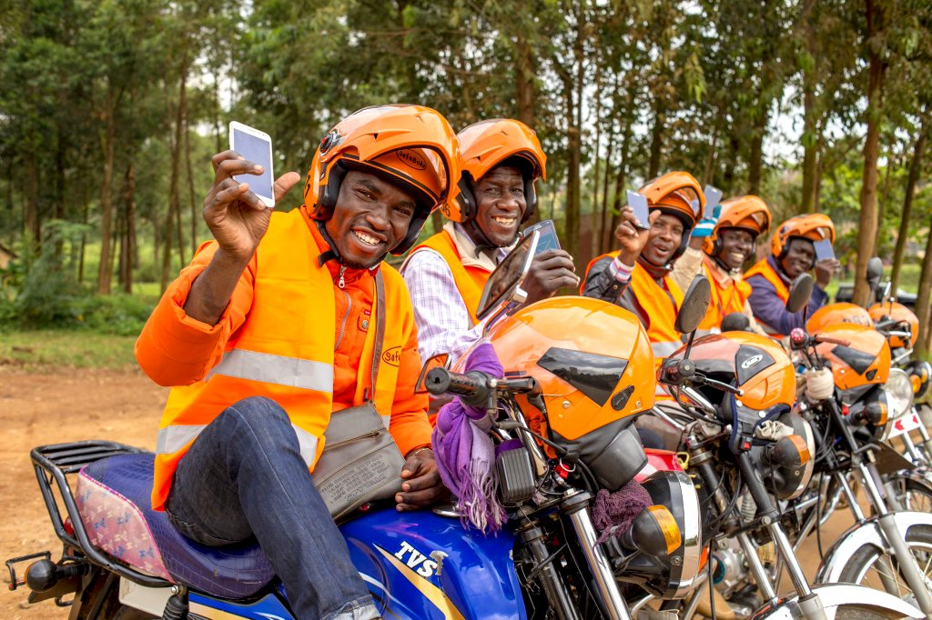
Thank you

